Slide 1



Exclusive rights
Copyright in the Digital Environment
Amy Thomas
28 January 2026

Slide 2
Format: 28 January
Economic rights
Moral rights
Dates for your diary:
Formative assignment (essay plan) due: 11 March 4pm
Summative assignment (essay of 4,500 words) due: 1 April 4pm

Slide 3
Work falls within copyrightable subject-matter + fixed permanently + meets the originality standard = copyright
Copyright in turn gives you a bundle of several (and severable) rights:
Economic
Moral

Slide 4
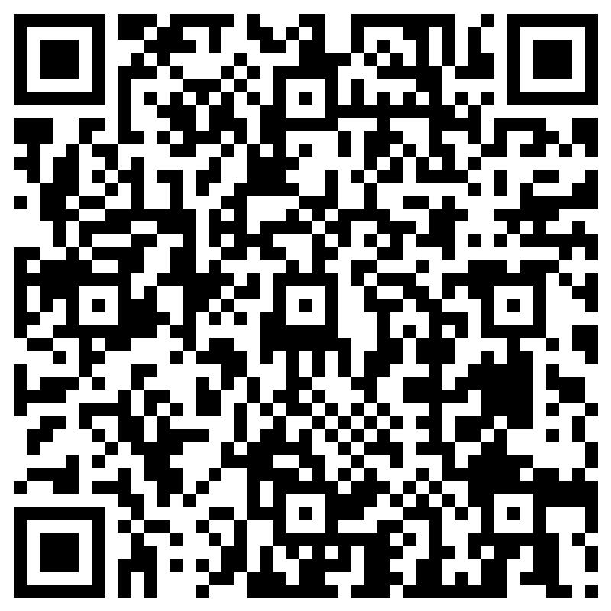
Participation activity
Can you think of something people regularly do online with creative content that everyone seems to accept (or is seen as normal) but that you suspect infringes someone’s (economic or moral) rights? Share one example.
https://forms.cloud.microsoft/e/aRdzj8fSKa

Slide 5
Participation activity
Can you think of something people regularly do online with creative content that everyone seems to accept (or is seen as normal) but that you suspect infringes someone’s (economic or moral) rights? Share one example.
Often there is a conflict between copyright law and social norms – copyright gives the holder an opportunity to take action, but they don’t have to
https://forms.cloud.microsoft/e/aRdzj8fSKa

Slide 6
Economic rights
CDPA s 16 – 24:
Reproduction
Distribution
Communication to the public
Adaptation
But see also: translations, lending and rental, broadcasting, public performance etc.

Slide 7
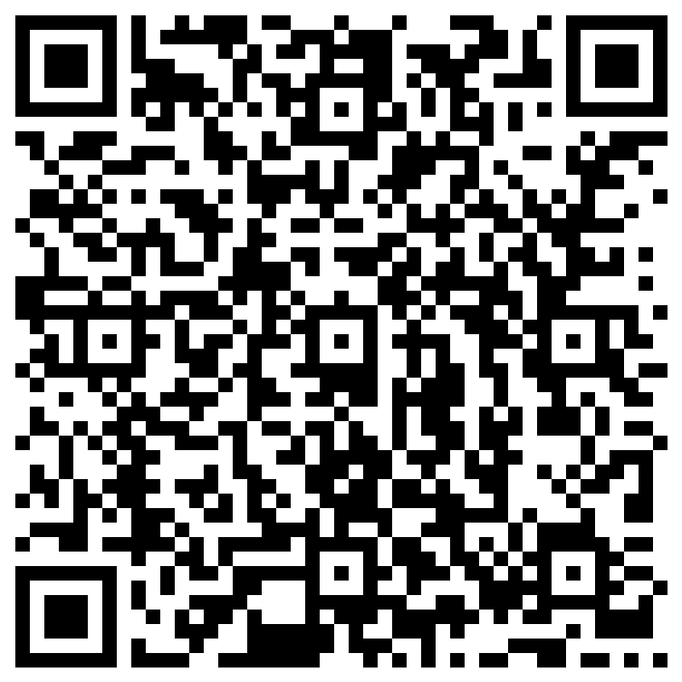
Reproduction
CDPA s16(1)(a): ‘to copy the work’ e.g. the copy right!
https://forms.cloud.microsoft/e/ptHi9f5K2V

Slide 8
Reproduction
In theory, applies to any type of copying: temporary, tangential, or minimal use of a work (InfoSoc Directive art 2(e) and 3(2)):
Literal copying – copy/paste, photocopy, screenshot (see Infopaq, Tixdaq)
Non-literal copying – emulating via another method/process
Key question: does the copy embody a substantial part of the author’s own intellectual creation?
In theory different from Pelham ‘part’ test: but what is ‘substantial’ is still a qualitative not quantitative metric
Note: this is why exceptions are very important in the digital environment (covered next week)

Slide 9
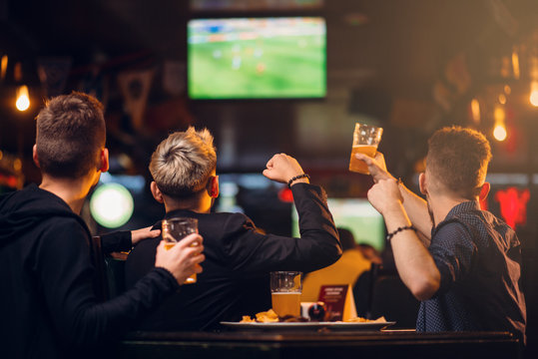
Reproduction: Literal copying
Cases C-403/08 and C429/08 Football Association Premier League Ltd v QC Leisure, Murphy v Media Protection Services Ltd
Landlady shows PL football matches in her pub, using a (paid-for) Greek subscription channel which was not licensed in the UK
Tiny parts of real-time live footage are technically copied (e.g., in an RAM), forwarded and instantly deleted
‘… it is not relevant whether a work is reproduced by means of linear fragments which may have an ephemeral existence because they are immediately effaced in the course of a technical process’ (para 157)

Slide 10
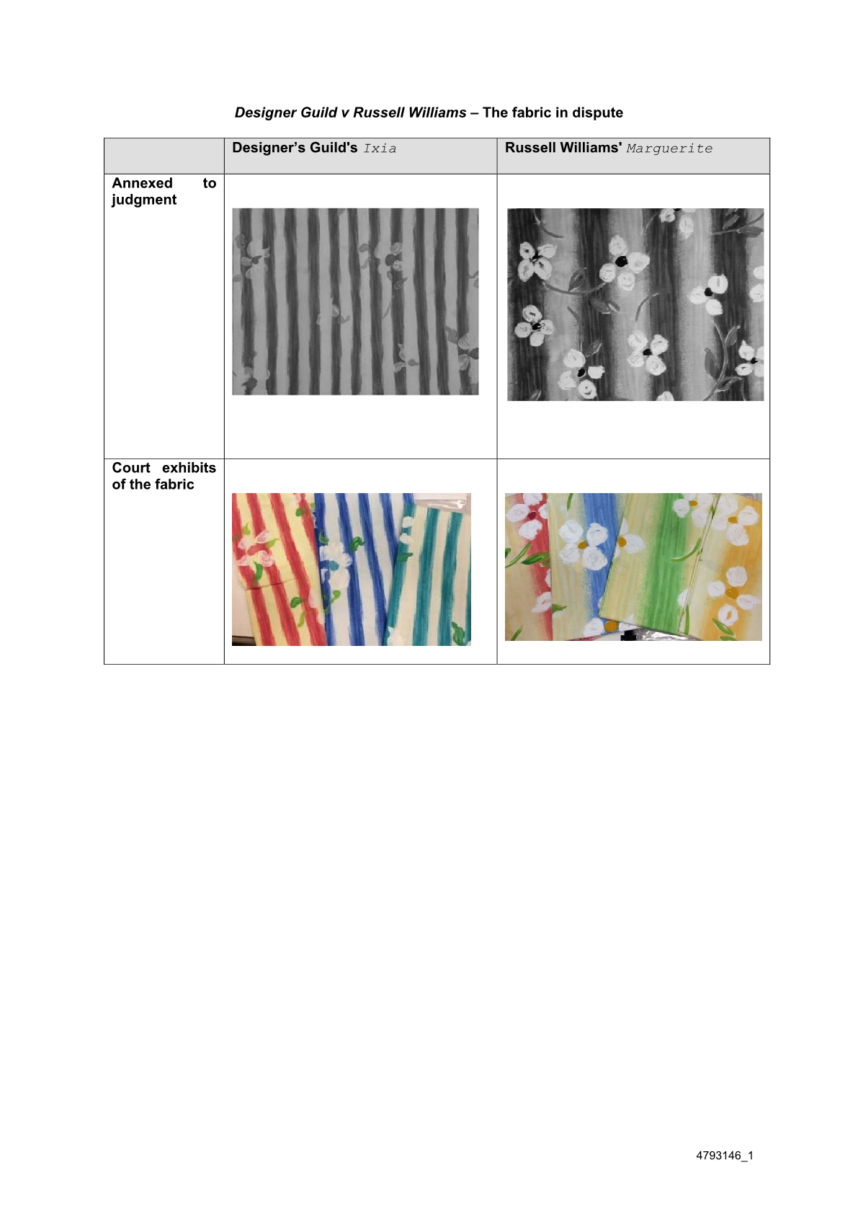
Reproduction: Non-literal copying
Designers Guild Ltd v Russell Williams (Textiles) Ltd [2001] FSR 11
Key question: can it be copyright infringement to copy an artistic technique/emulate an artistic effect?
‘… a copier is not at liberty to appropriate the benefit of another’s skill and labour’

Slide 11
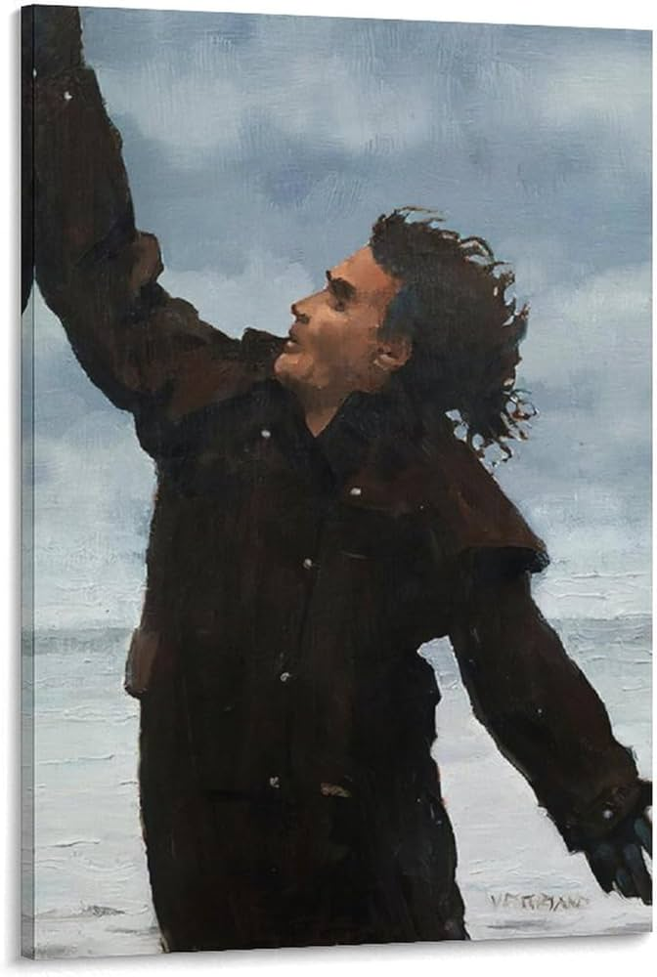
Distribution
CDPA s16(1)(b)to issue copies of the work to the public
Note: the principle of exhaustion (in the US: first sale doctrine) limits this right
C-419/13 Art and Allposters v Stichting Pictoright
Exhaustion only applies to the distribution right, not the reproduction right
Is the altered object, taken as a whole, physically the same object that was placed on the market with the consent of the rightsholder?
Image credit

Slide 12
Digital exhaustion: example essay question
Do the principles of exhaustion work in the digital environment? Should you be able to re-sell e.g., a digital copy of a song or photograph? Think about the policy implications: why are second hand digital works different from real property?

Slide 13
Digital exhaustion: example essay question
EU (UK) Digital exhaustion sometimes | US No digital exhaustion
UsedSoft GmbH v Oracle International Corp (second hand digital software – lex specialis Software Directive) Nederlands Uitgeversverbond and Groep Algemene Uitgevers v Tom Kabinet Internet BV (second hand digital audio-visual works – InfoSoc Directive) | Capitol Records, LLC v. ReDigi Inc ‘the fact that a file has move from one material object [the user’s computer] to another [the ReDigi server] means a reproduction has occurred’

Slide 14
Communication to the public
S16(1)(d) ‘to communicate the work to the public’
e.g., streaming, hyperlinking…?
+20 CJEU judgements since 2006! See e.g., SGAE (C-306/05), Svensson (C-466/12), Bestwater (C-348/13), GS Media (C-160/15)
Note: you are not expected to engage with this right in-depth for the purposes of this course (covered in: Digital Media Creators, Contemporary Issues in Intellectual Property)

Slide 15
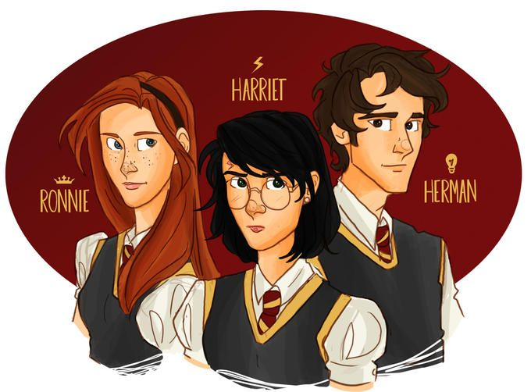
Adaptation
S16(1) (e) ‘to make an adaptation of the work or do any of the above in relation to an adaptation’ (change in form)
Relation to derivative works (incorporates original work from re-creator), new works, and infringement
Note: difference between UK (reserved right) vs US (a ‘fair use’ sometimes)
Is changing the gender of a fictional character (e.g., from man -> woman, colloquially known as ‘gender bending’) in a fan work an ‘adaptation’ or ‘derivative work'?
Image Source

Slide 16
Moral rights
Included in the Berne Convention (and Chapter IV CDPA, s77 – 89)
Concerned with the personal connection an author has with their work
Tend to be stronger in civil law jurisdictions rather than common law jurisdictions
In the UK, moral rights can’t be licensed or assigned, but can be waived (forfeited) in the UK

Slide 17
Paternity (attribution)
CDPA s77
Right to be named and acknowledged as the author
You can also object to false attribution (see also: WIPO Internet Treaties, InfoSoc Directive)
Some online communities prefer anonymity and pseudonymity (see Fiesler (2018) Everything I Needed to Know: Empirical Investigations of Copyright Norms in Fandom)
Limitations:
Only applies to literary, dramatic or musical works
Needs to be asserted

Slide 18
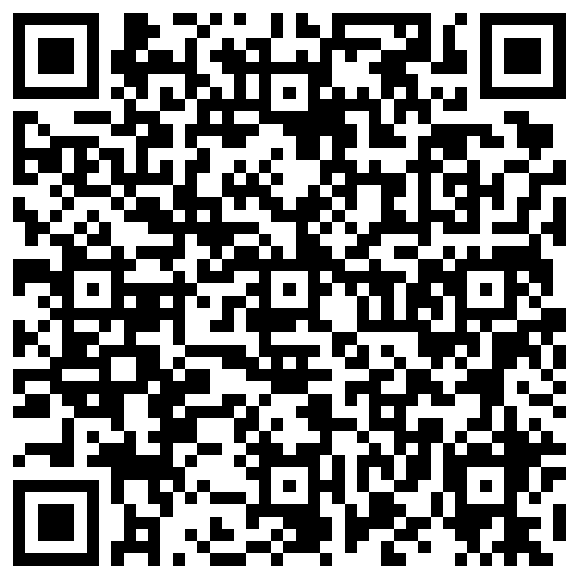
Paternity (attribution)
How is attribution managed in the digital environment? How do people make sure they are ‘attributed’ when sharing content online?
https://forms.cloud.microsoft/e/gFfmH2cXNt

Slide 19
Integrity (derogatory treatment)
CDPA s80
The right to object to distortion or alteration of your work that is ‘prejudicial to the author’s honour or reputation’ (Berne Convention)
Note: doesn’t apply to computer programmes, computer-generated works or sound recordings
See: Confetti Records & Others v Warner Music UK Ltd (subjective judgement – objective measurement)

Slide 20
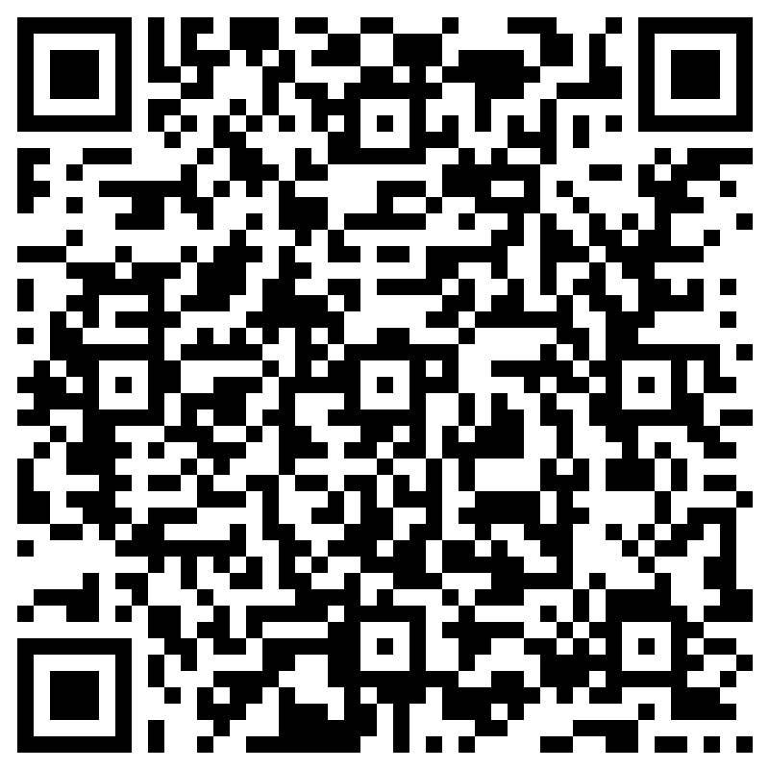
Integrity (derogatory treatment)
Consider the following scenarios. Do you think they can be considered a ‘derogatory treatment’ within the meaning of the integrity right?
https://forms.cloud.microsoft/e/KT8UNYZGMd

Slide 21
Duration of rights
Berne stipulates a minimum protection of 50 years after the author’s death.
Written, dramatic, musical and artistic work -> 70 years after the author’s death
Sound and music recording -> 70 years from when it’s first published
Films -> 70 years after the death of the director, screenplay author and composer
Broadcasts -> 50 years from when it’s first broadcast
Layout of published editions of written, dramatic or musical works -> 25 years from when it’s first published
Why do you think copyright duration keeps getting longer?

Slide 22
Duration of rights
Joint authorship: calculated from the date of the death of the last living author
Company copyright: calculated from the death of the author
Performers rights: 50 years from the date of release (non-sound recordings), 70 years from the date of release (sound recordings only)
After copyright expires, works enter the public domain.

Slide 23
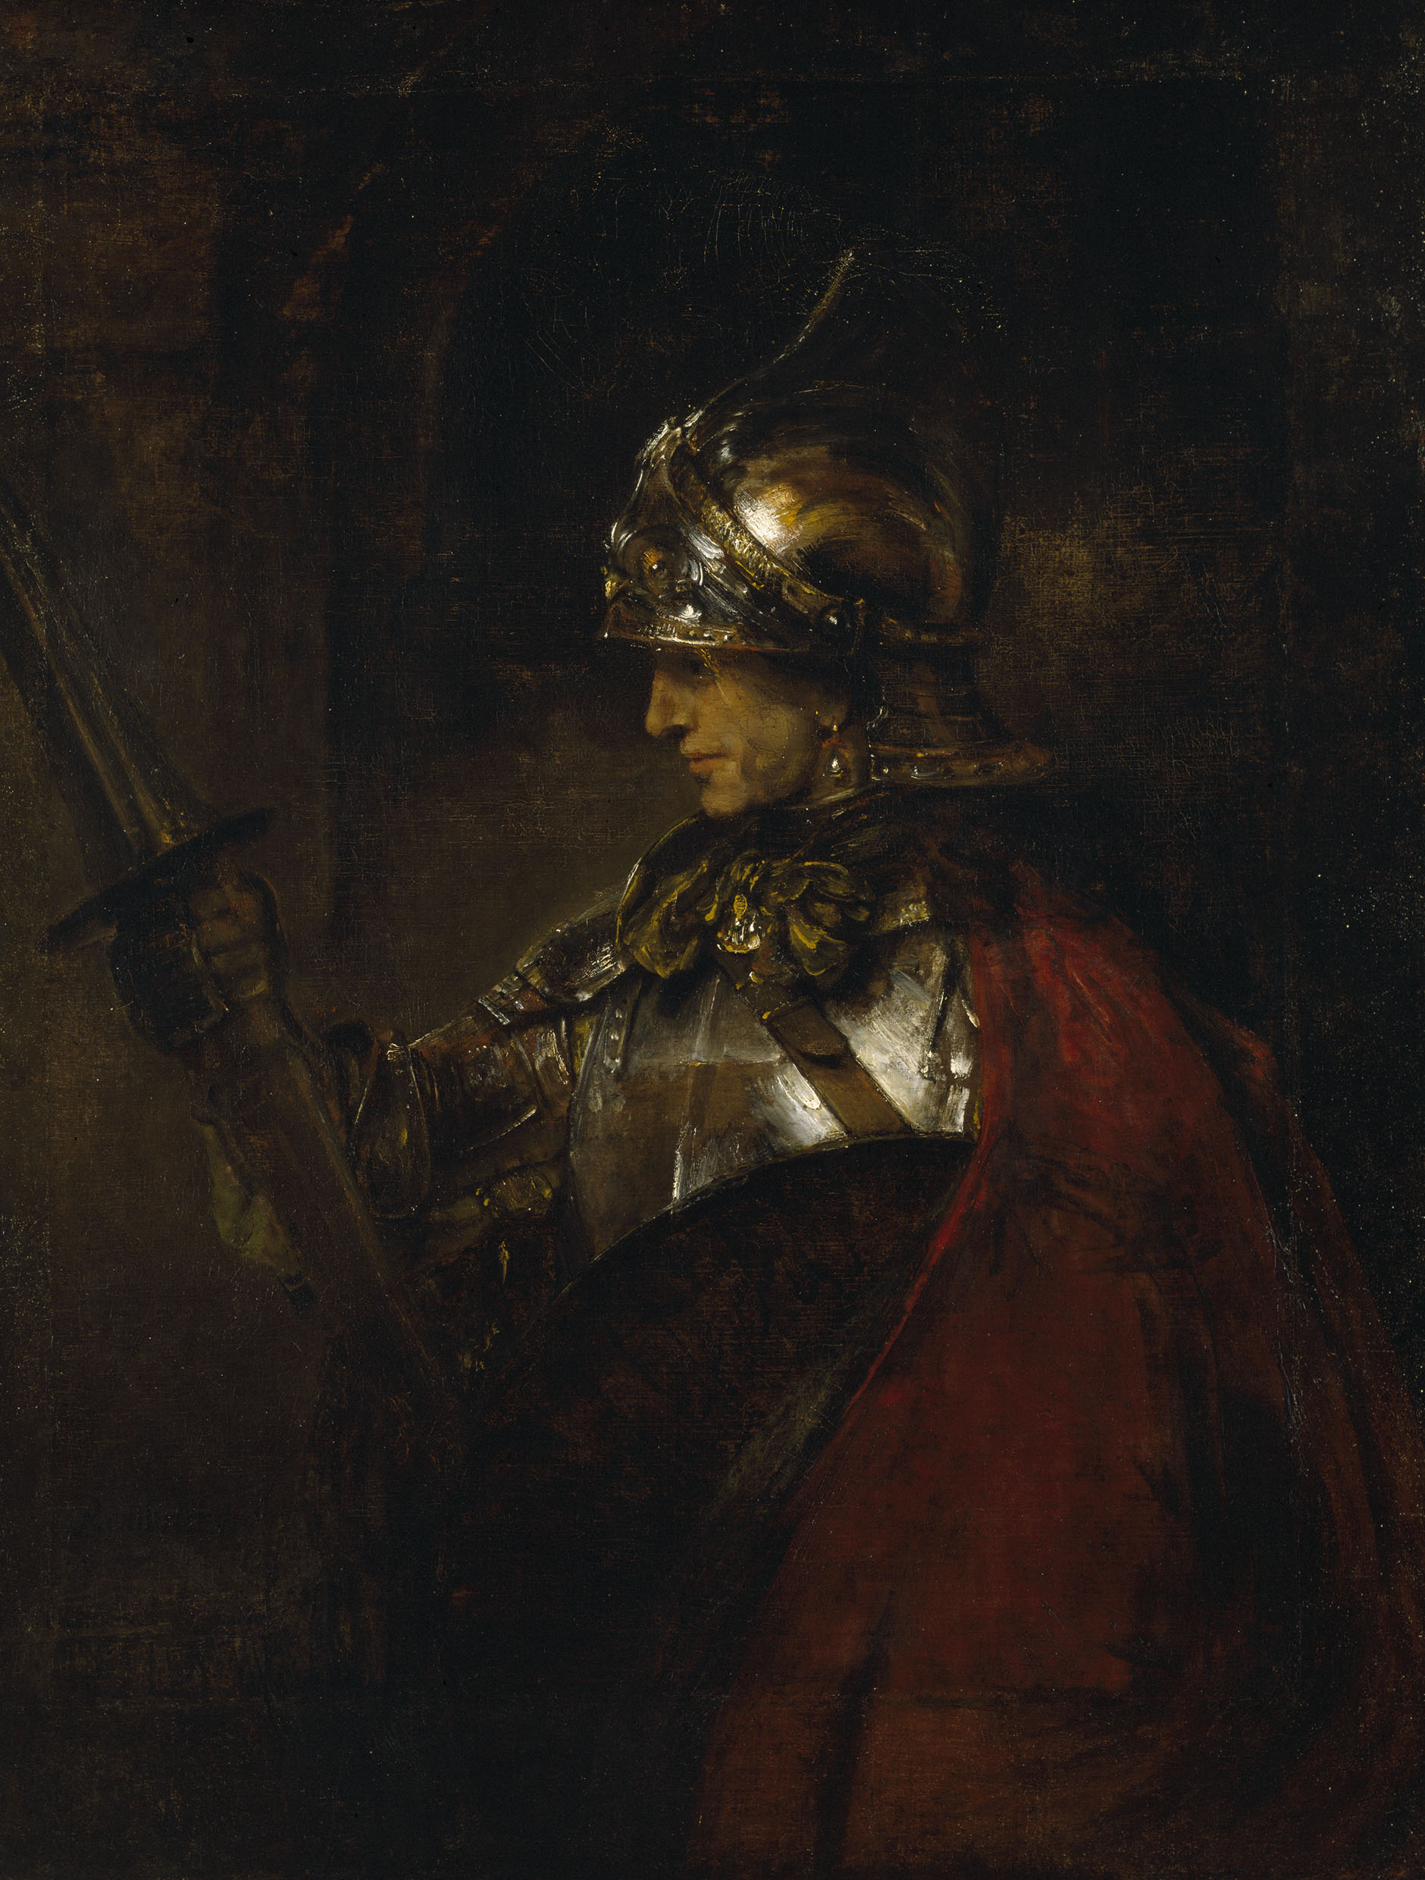
Example problem question
You find this picture of Rembrandt’s ‘A Man in Armour’ (1655) in a Google Image search.
Are you allowed to copy this picture and sell it on posters on Etsy?
Would your answer change if you were the person taking the picture (rather than copying someone else’s from Google)?
Image source

Slide 24
Next week…
Readings/preparation for next week (Exceptions and limitations)
Office hours: Wednesdays 1:30pm – 2:30pm (amy.thomas@glasgow.ac.uk)

